Slide 1


Name: Aarav Mahajan class: X-”B” Roll No:”1” Submitted to: Mrs. Suman ma'am
A BAKER FROM GOA

Slide 2
Table of Contents
Introduction
Table of contents
About GOA
About the author
About the chapter
Theme
Message
Plot
Chapter preview
Short video
Word meanings
Characters of the story
RTC Questions
SAQ Questions
LAQ Questions
References
Thank you

Slide 3
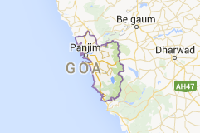
GOA… Goa is unlike any other state of India. It is the smallest state of the country and Panaji or Panjim is its capital. It has a unique international atmosphere and layering, which is seen in its festive atmosphere and becalming halo. Goa was a Portuguese colony for centuries, from about 1510 until 1961, and this has left behind strong traces of foreign power here.

Slide 4
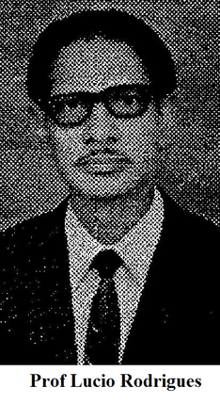
About the Author:
Lucio Rodrigues: Lover of Goa and Teacher Par Excellence Professor Lucio Rodrigues( (1916-73) is another one in a long line of literary geniuses that Goa has produced. He may have long departed this world but nevertheless his legacy of literature lives on through his writing and his students. He wrote several articles in English and Konkani to various periodicals and magazines. He served as the visiting professor of Folklore at many universities and also as a professor of English in Mumbai and Goa. His essays were posthumously published under the title ‘Of Soil and Soul’ and Konkani Folk Tales’. Subtle humour and informal narration are the essential features of his writings.

Slide 5
ABOUT THE CHAPTER……
This is a pen-portrait of a traditional Goan village baker who still has an important place in the society. What changes take place in the life of the baker with the passage of time a glimpse is presented in this extract.

Slide 6
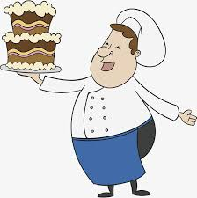
THEME:
The writer presents a pen-portrait of a traditional Goan village baker who still has an important place in its society. Elders still think fondly of the famous Portuguese loaves of bread. The family tradition is still carried on even today by the new generation of bakers or pads in Goa. Even today, marriage gifts are meaningless without the sweet bread or the bol, just as a party or a feast loses its charm without Goan bread.

Slide 7
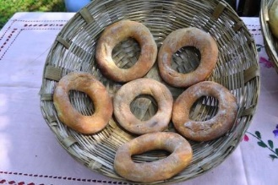
Message:
‘A Baker from Goa’ highlights the importance of the traditional practice of making breads for every occasion and festival of the Goan people. This tradition continues even today. This shows how our traditional practices can keep us to our past and heritage. Traditional values shape our personality and also provide us emotional support. They enable us to face difficult situations and makes us mentally strong. Traditional practices also have an impact on our behavioural pattern towards the other people in society.

Slide 8
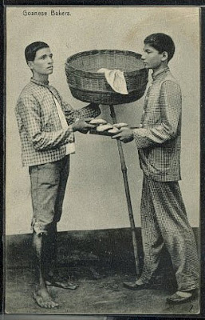
Plot:
The baker comes with the jhang-jhang sound, a sound of his bamboo stuff. His one hand supports the basket of his head and the other hand the bamboo on the ground. The baker places the basket and the imploring children surround him to look into the basket what variety of eatables
he carries. They buy the loaves and even eat without brushing.

Slide 9

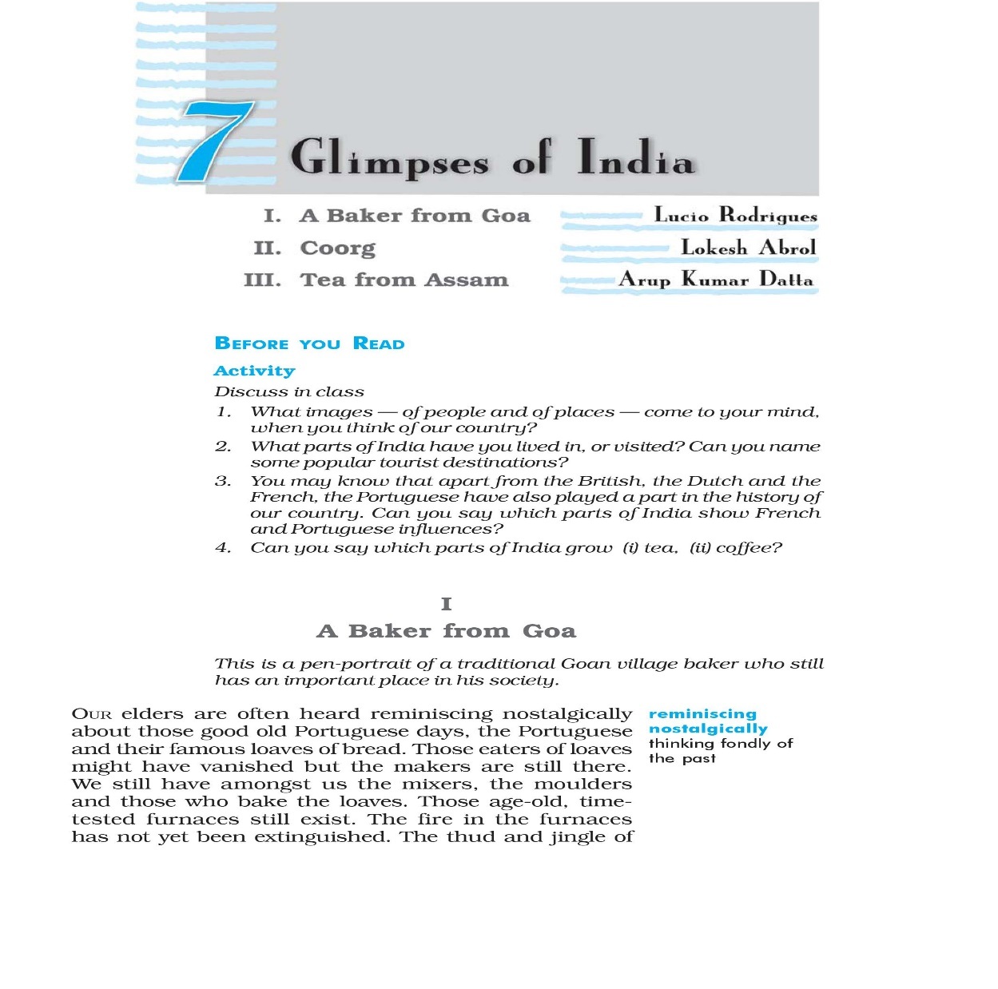

Slide 10
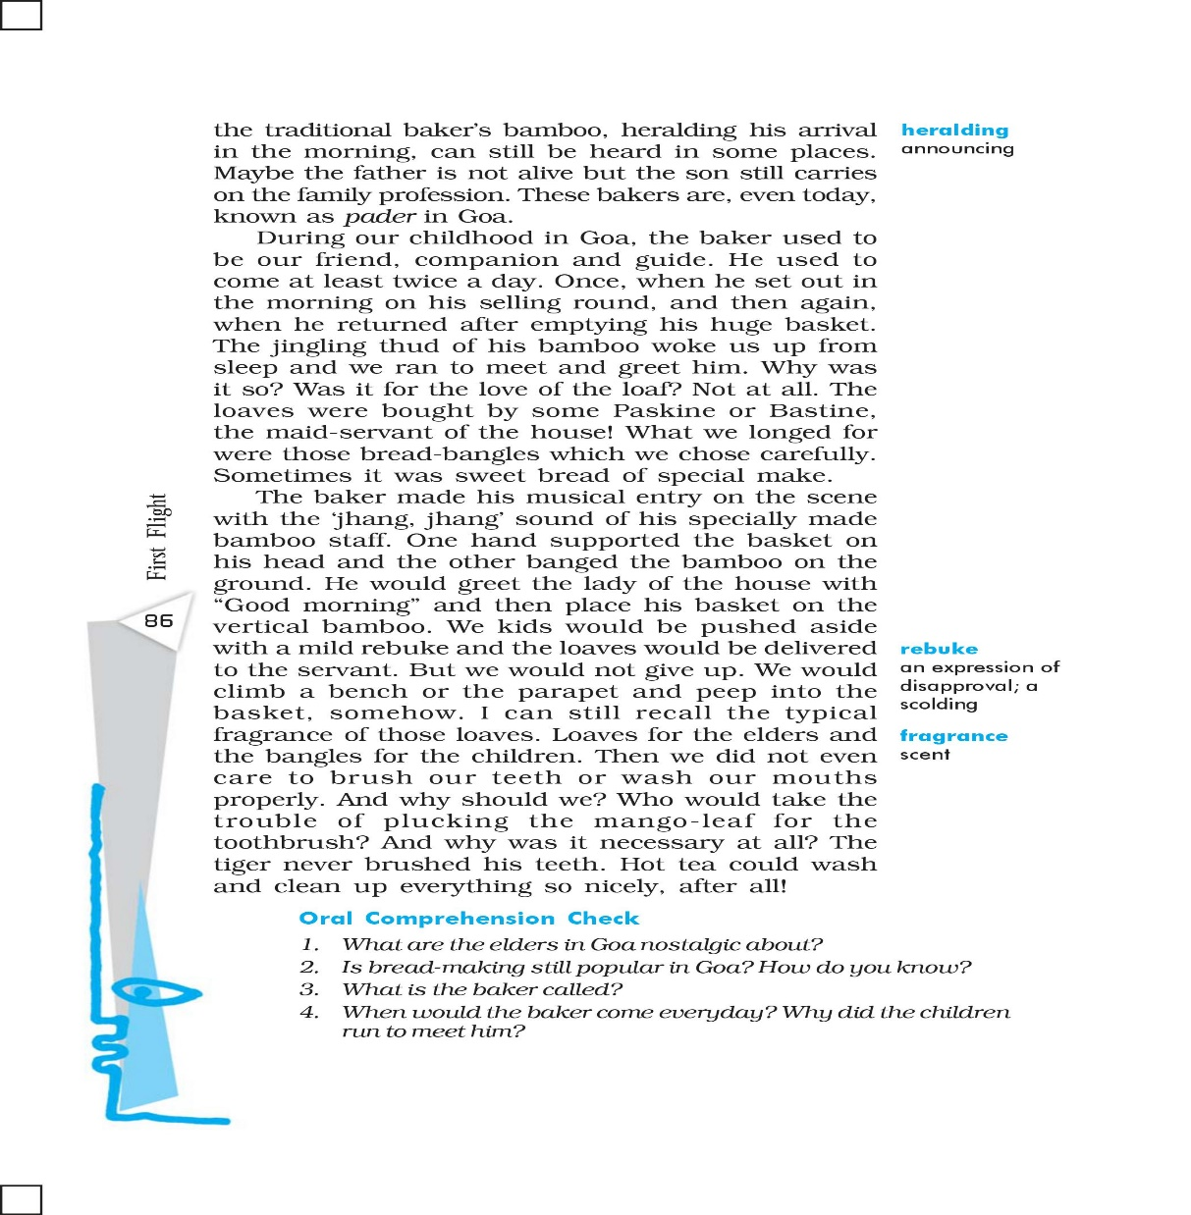

Slide 11
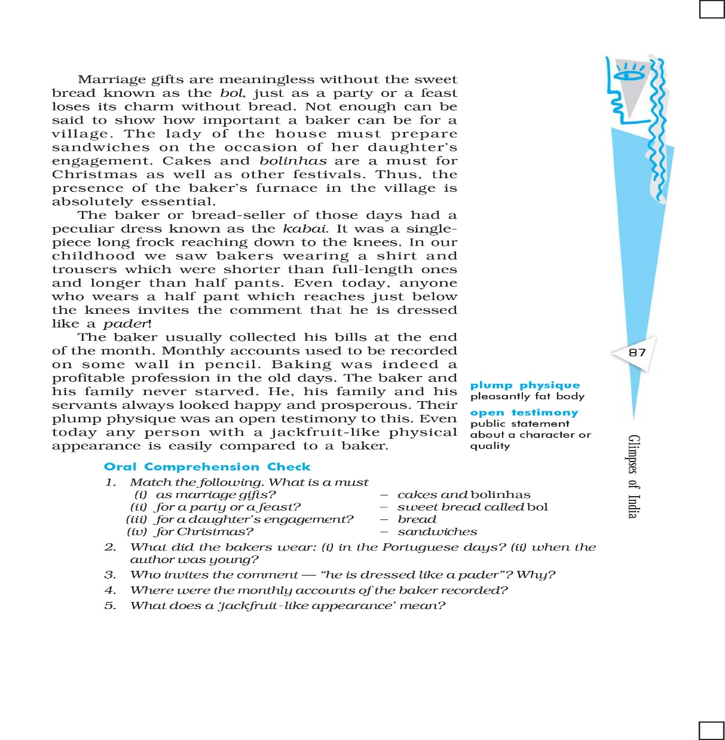

Slide 12

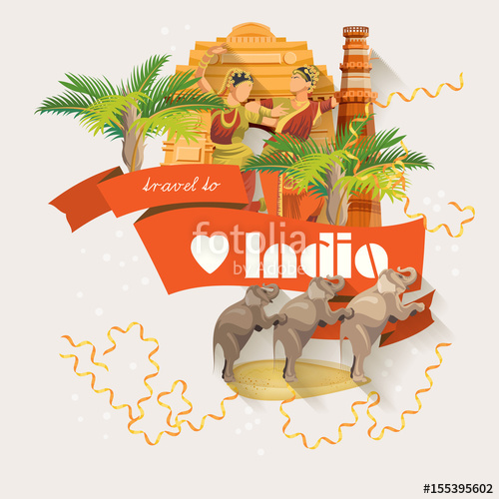
Short Video:

Slide 13
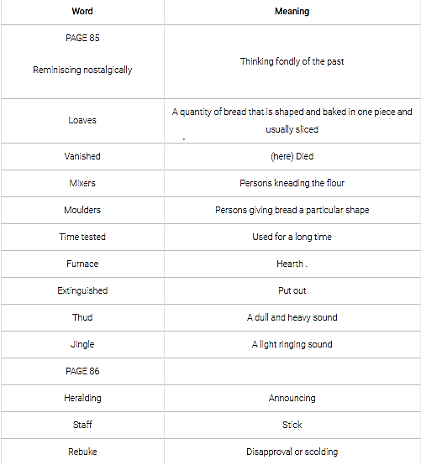
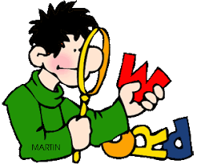
Word Meanings:
Vocabulary Building:

Slide 14
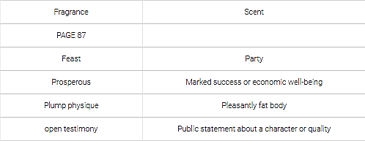

Word Meanings:

Slide 15
Characters of the story.
Baker:
The baker or bread-seller of those days had a peculiar dress known as the kabai. It was a single piece long frock reaching down to the knees. In our childhood we saw bakers wearing a shirt and trousers which were shorter than full-length ones and longer than half pants. Even today, anyone who wears a half pant which reaches just below the knees invites the comment that he is dressed like a pader.

Slide 16
Other Characters:
Children & elders:
The children used run to meet the baker the moment they heard the jingling thud of his bamboo. The baker used to greet the lady of the house. The elders used to enjoy the typical fragrance of those loaves and the kids, the music of the bamboo.

Slide 17

RTC Questions:
Read the following passages and answer the questions that follow :
Our elders are often heard reminiscing nostalgically about those good old Portuguese days, the Portuguese and their famous loaves of bread. Those eaters of loaves might have vanished but the makers are still there. We still have amongst us the mixers, the moulders and those who bake the loaves. Those age-old, time-tested furnaces still exist. The fire in the furnaces has not yet been extinguished. The thud and jingle of the traditional baker’s bamboo, heralding his arrival in the morning, can still be heard in some places. Maybe the father is not alive but the son still carries on the family profession. These bakers are, even today, known as pader in Goa.

Slide 18
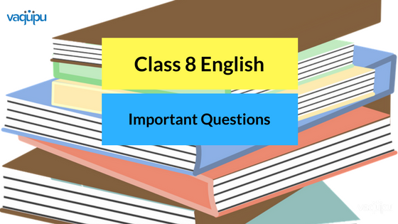
RTC Questions:
(a) What do the elders remember nostalgically?
(b) Whom do the residents of Goa still have among them?
(c) What are the time tested things which still exist there?
(d) How are the bakers known as in Goa?
(e) Find a word from the passage which means ‘put out’.
Class 10 English
Answers:
(a) They remember nostalgically the old Portuguese days and the loaves of bread.
(b) They still have the mixers, the moulders and bakers of bread.
(c) The furnaces of the bakers are the time-tested things which still exist there.
(d) The bakers are known as pader.
(e) ‘extinguished’.

Slide 19
RTC Questions:
2. During our childhood in Goa, the baker used to be our friend, companion and guide. He used to come at least twice a day. Once, when he set out in the morning on his selling round, and then again when he returned after emptying his huge basket. The jingling thud of his bamboo woke us up from sleep and we ran to meet and greet him. Why was it so? Was it for the love of the loaf? Not at all. The loaves were bought by some Paskine or Bastin, the maid-servant of the house! What we longed for were those bread-bangles which we chose carefully. Sometimes it was sweet bread of special make.
Questions:
(a) What was the baker’s place in Goa in the author’s childhood days?
(b) What happened after the author woke up on hearing the baker’s jingling sound?
(c) Who bought the loaves?
(d) What did the narrator long for?
(e) Find a phrase front the passage which means ‘wished for’.

Slide 20

RTC Questions:
Answers :
(a) In those days the baker was the friend, companion and guide.
(b) He ran to meet and greet hint.
(c) The maid-servant of the house bought the loaves of bread.
(d) The author longed for ‘bread-bangles’.
(e) ‘longed for’.

Slide 21
SAQs
1. What did the baker mean to the narrator during his childhood? How many times did he pay a visit?
Ans. The baker or pader was an important person in the author’s life. He was treated like a friend. He used to come twice a day, once in the morning to sell the bread and then while returning after emptying his basket. The author used to run to meet him in order to take the bread-bangles. He chatted and gossiped with him.
2.What were the bakers called? Describe their peculiar dress.
Ans. The bakers were known as pader. These bakers wore a peculiar dress known as the ‘kabai’. It was a single piece long frock reaching down to the knees.

Slide 22
SAQs
3. What was Kabai ? Give a brief description.
Or
What did the bakers wear — (i) in the Portuguese days? (ii) When the author was young?
Ans. Kabai wan a particular dress — a single piece long frock reaching down the knees which the bakers used to wear in old days. Later it was replaced by a shirt
and trousers which were longer than the shorts and shorter than the full length.
4. What are the elders in Goa nostalgic about?
Ans. In Goa, the elders are nostalgic about the good Old Portuguese days as well as the Portuguese and their famous loaves of bread.

Slide 23
SAQs
5. How can you say, ‘bread-baking is still popular in Goa’?
Ans. Bread making is still very popular in Goa. Still, we can see the mixers, the moulders and those who bake the loaves. Most of their festivals and other occasions are meaningless without the loaves of bread.
6. “Even today any person with a jackfruit-like physical appearance is easily compared to a baker.” Explain.
Ans. Bakers had a plump physique which meant they were happy and prosperous and hence, even today, any person with a jackfruit like physical appearance is compared to a baker.

Slide 24

LAQs
1. Why was it absolutely essential to have a “baker’s furnace” in a Goan village?
Ans. The Portuguese and their famous loaves of bread had made a permanent impact on Goan soil. The eaters of those loaves might have vanished but the makers of the loaves — the bakers still have an important place in the society. The Goan village still has the mixers, moulders and those who bake the loaves. There are also the age-old time-tested furnaces which exist till date. The bakers are still important in the village. The lady of the house must Prepare sandwiches on the occasion of her daughter’s engagement. Cakes and bolinhas are a must for Christmas as well as other festivals. Thus, the presence of the baker’s furnace in the village is still essential.

Slide 25

LAQs
Q7. What do our elders are often heard reminiscing nostalgically about in Goa? Did the old profession of making the famous loaves of bread end with the Portuguese?
Ans. Our elders in Goa are often heard reminiscing nostalgically about the good old Portuguese days. They are often heard saying nostalgically about their famous loaves of bread. Many eaters of loaves might have vanished but the makers are still alive. The profession of baking loaves of bread has not died with ending of the Portuguese rule. Goa still has the mixers, the moulders and the bakers of those loaves. The furnaces still bake those unique loaves of bread. Even today one can hear the thud and jingle of the traditional baker’s bamboo in the morning. Marriages, feasts, Christmas and other festivals are meaningless without the sweet bread known as the bol. The baker’s presence in even Goan village is absolutely essential. Baking was indeed a profitable profession in good old days. However, the tradition hasn’t died completely yet.

Slide 26
Quick Recap:
Elders often think fondly of good Portuguese days and their famous loaves of bread.
The age-old furnaces still bake those bread.
The thud and jingle of the baker’s bamboo announcing his arrival can still be heard in some places.
Even today, these bakers are known as Pader in Goa.
The children ran to meet and greet him.
They longed for bread-bangles and sweet bread of special make.
Marriage gifts were meaningless without the sweet bread known as the ‘bor.

Slide 27
Quick Recap:
8.The lady of the house must prepare sandwiches on the occasion of her daughter’s engagement.
9.Cakes and `bolinhas’ are a must for Christmas and other festivals.
10.The presence of the baker’s furnace in the village is absolutely essential.
11.The bakers in the old days used to wear a dress known as the kabai.
12.Baking was quite a profitable profession in the old days.
13.The baker and his family always looked happy and prosperous.

Slide 28
REFERENCES
WEBSITES.
CBSE SAMPLE PAPERS
EDUMANTRA
CBSE TUTS
NVSENG10.WEEBLY
NCERT BOOKS
YOUTUBE
BOOKS.
NCERT FIRST FLIGHT -CLASS 10

Slide 29


DROP YOUR QUERIES AT:
Email: aaravmahajan2003@gmail.com

